Slide 1
The Detection of R-Peaks in Electro-cardiogram(ECG)
By-
Asim Anand - 21BEC1519
Sudhanshu Kumar - 21BEC1466

Slide 2
ECG INTRODUCTION
ECG - ECG stands for Electrocardiogram
ECG is representative signal containing information about the condition of the heart.
It is characterized with different frequency content QRS complex, P & T waves.

Slide 3
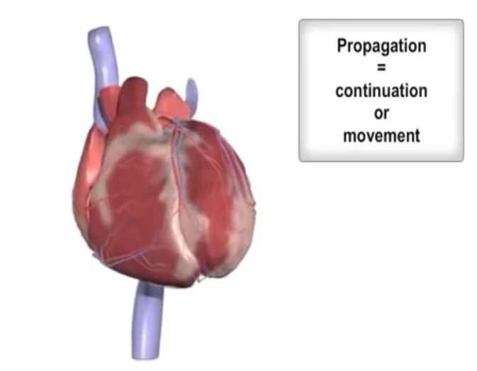
ECG INTODUCTION
The heart muscles contract and expand to generate signals that is recorded as ECG.
ECG is the measured electrical activity of the heart.

Slide 4
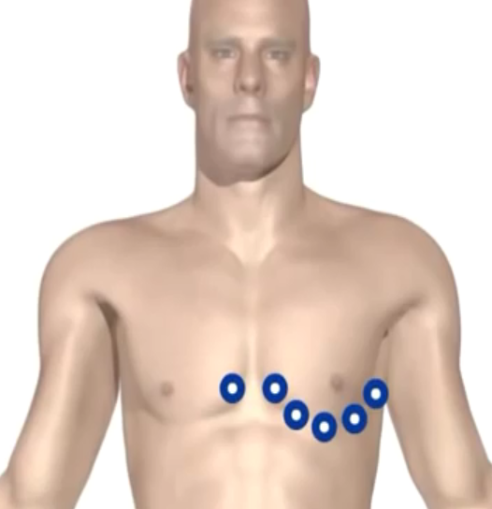
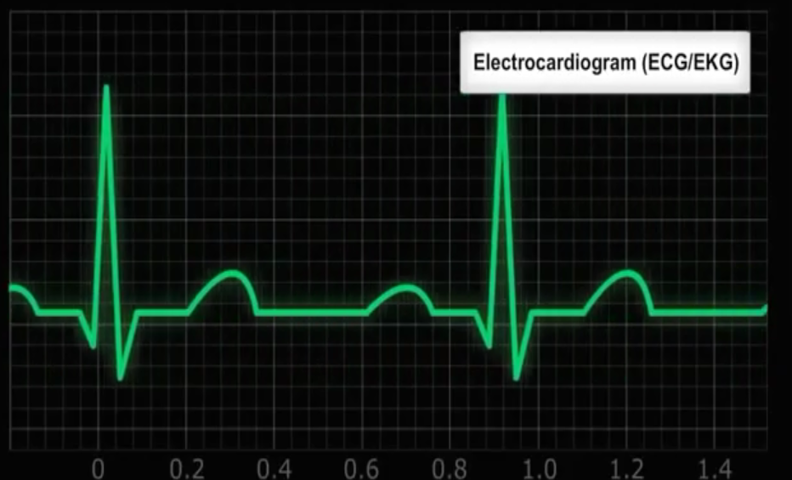
ECG Introduction
This electrical activity and be measured by placing electrodes at specific points on the skin.

Slide 5
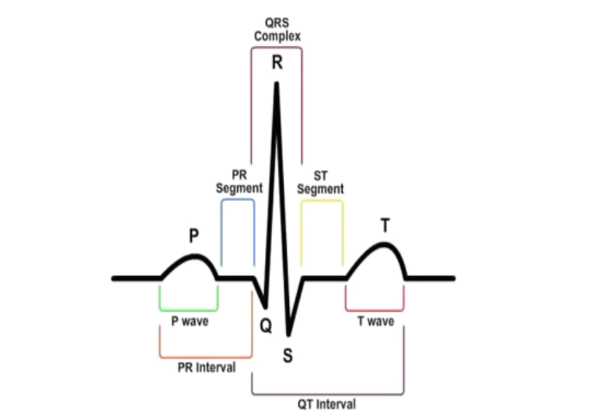
ECG Introduction

Slide 6
ECG INTRODUCTION
P Wave - ECG deflection representating atrial depolarization. Atrial repolarization occurs during ventricular depolarization and is obscured.
QRS Wave - ECG deflection representating ventricular depolarization.
T Wave - ECG deflection representiing ventricular repolarization.

Slide 7
OBJECTIVE OF OUR PROJECT
The basic task of the electrocardiogram processing is peaks detection. The R peaks are determine the abnormality in the beat, tall QRS are usually caused by hypertrophy. So, the main aim of our project is to find R peaks in the ECG signal as it is the most important step for diagnosis of cardiac disorders, heart-rate variability, biometric, and ECG coding systems.

Slide 8
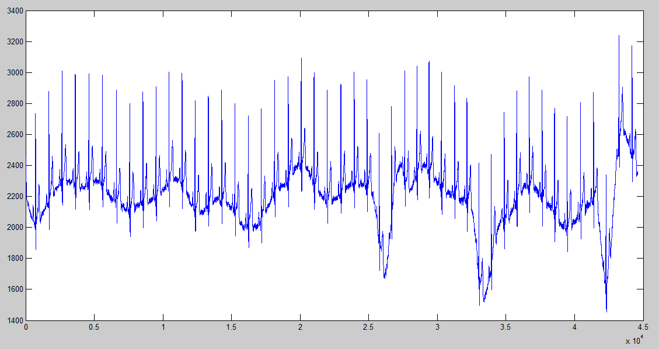
R-peaks detection in MATLAB
The ECG signal we are going to work with looks like this.

Slide 9
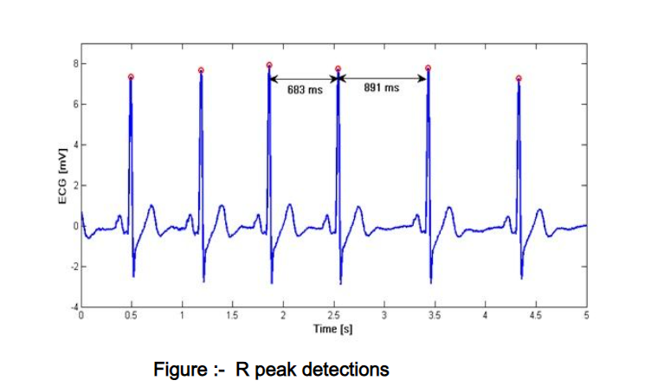
R-peaks detection in MATLAB
A closer look at the signal

Slide 10
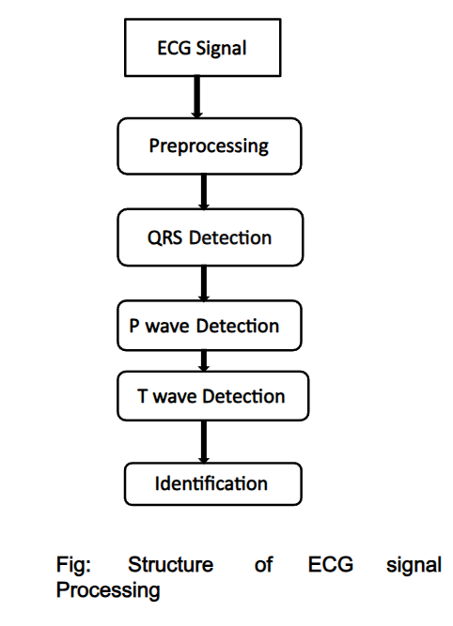

Slide 11
NOISES IN ECG
ECG signals are affected by noises such as baseline wandering,power line interference,mascular noise, and high frequency noises during data acquisition.
The effect of noise on the repeatability of computer measured PR interval,QRS duration,QT interval and ST level were examined.
In order to eliminate the noises present in the ECG signal we will use different types of transformation methods.

Slide 12
HILBERT TRANSFORM
The accurate detection algorithm of QRS wave,R peak height,T peak,ECG base modulation technique based on first derivative of Hilbert transform is proposed. First derivative which is implemented on smooth ECG signal is basically a high pass filtering which allow high frequency,QRS complex and attenuate low frequency P&T wave region. Now hilbert transform is implemented on the differnetiated signal. Maximum amplitude of the transformed signal is found out.

Slide 13
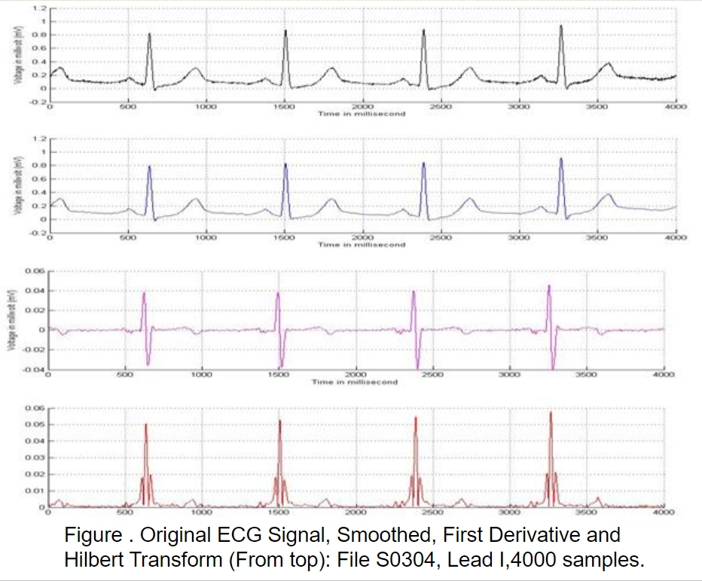

Slide 14
FFT TRANSFORM
Fast fourier transforms are used to identify the peaks in the ECG signal and the neural networks are applied to identify the diseases.
In FFT that produces the signal into an infinte length of sine and cosine wave functions.However, the transform losses the information is about time domain and gives only spectral information in frequency domain and vice versa.

Slide 15
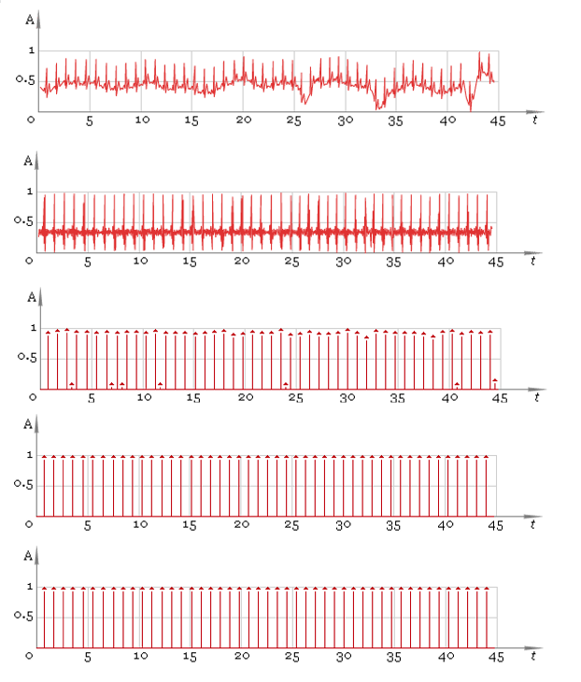

Slide 16
WAVELET TRANSFORM
The wavelet transform is a time-scale representation that has been used successfully in a broad range of applications, in particular signal compression.
Recently, Wavelets have been applied to several problems in Electrocardiology, including data compression, ananlysis of ventricular late potentials, and detecttion of ECG characteristics points.
One of the best advantage of the wavelet transform is that it is able to decompose signals at various resolutions, which allows accurate feature extraction from non-stationary like ECG.

Slide 17
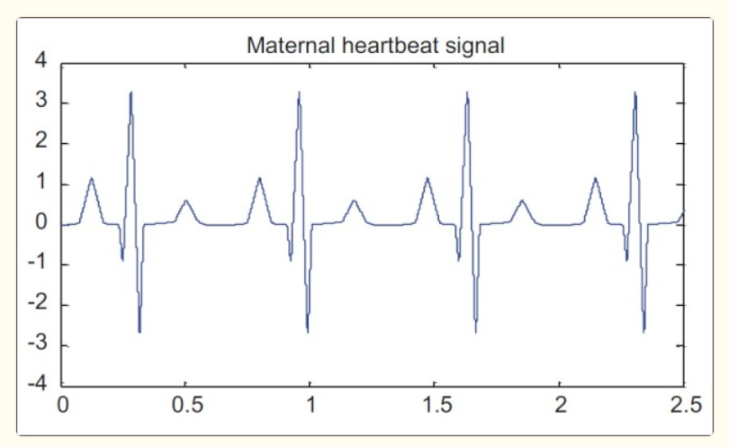
HOW ARE WE GONNA DO IT?
An ECG signal will be modeled using MATLAB software, then by adding Gaussian noise with different levels of SNR, are compared together for R peak detection.

Slide 18
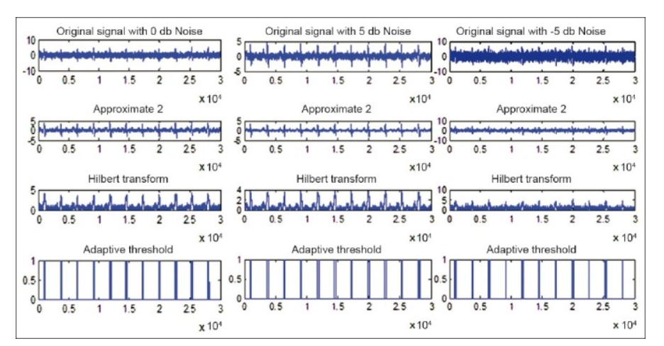

Slide 19
CONCLUSION
We will be finding an optimal combination of several introduces algorithms for R peak detection in order to achieve the better results, especially in noisy environments.
The wavelet transform, Hilbert transform has a significant effect in the detection of R wave.

Slide 20
References
Most of the content in this presentation has been picked up from
Medo Yasar YouTube Video -https://www.youtube.com/watch?v=KWrzdJY4G9Q
Matlab Code -
https://in.mathworks.com/help/wavelet/ug/r-wave-detection-in-the-ecg.html

Slide 21
Thanks!

